Slide 1
Loan Approval prediction system

Slide 2
Concept
Type of problem
Classification Technique used (Logistic Regression Model)
By looking at the columns and the description we can make some assumptions which may include;
The one whose salary is more can have a greater chance of loan approval.
The one who is graduate has a better chance of loan approval.
Married people would have a upper hand than unmarried people for loan approval.
The applicant who has less number of dependents have a high probability for loan approval.
The lesser the loan amount the higher the chance for getting loan.

Slide 3
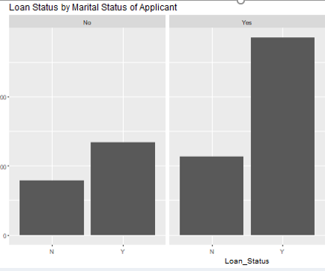
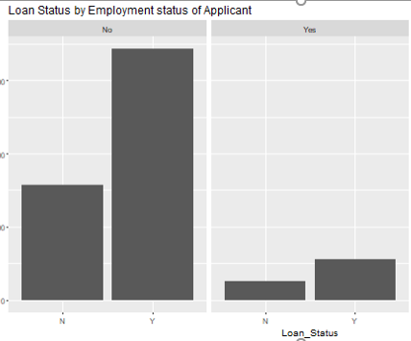
Comparison of the variables with the loan status
A larger proportion of not married applicants are refused than married ones.
Not self-employed seems to be slightly preferred to increase on the chances of acquiring a loan

Slide 4
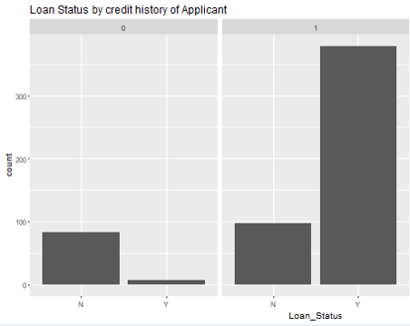
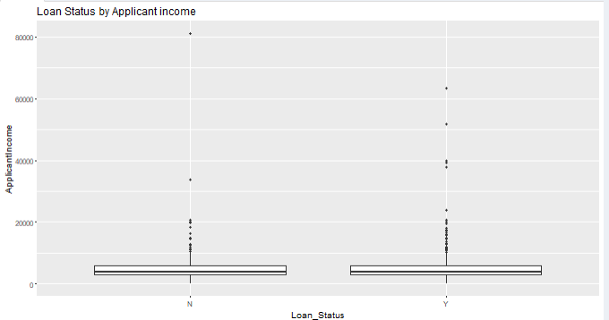
Almost all applicants with history=0 are rejected
Shows that low income people are mainly applying for loans and number of loan rejection is more in the lowest income segment

Slide 5
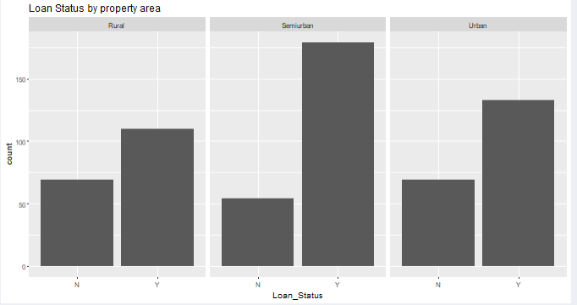
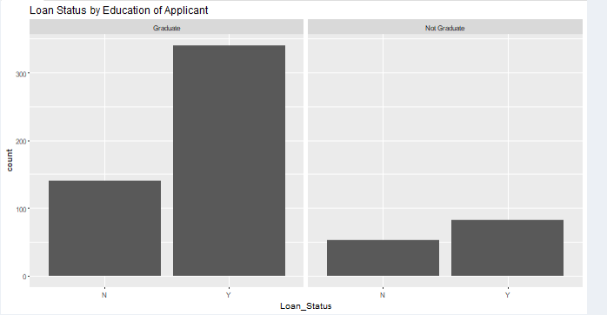
There are increased chances of getting a loan if the property is semi urban and hardest if it is rural
A larger proportion on non-graduates are refused than graduates

Slide 6
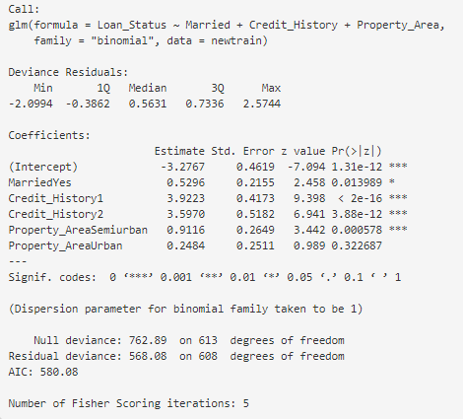
Logistic regression
We combined the train and test dataset into a single data frame, in order to tide the data so as to eliminate missing values in both datasets.
Used the rpart prediction model for some numeric variables to predict missing values, used logic extracted from the visualization to determine other missing values.
Later split the data frame into train and test data frames. Gained an accuracy of 83.9237057220708 using the variables, Married, Credit History and Property Area basing on the P Value using the logistic regression model (glm)

